Slide 1

Subject: MLP305x_1.1-A_VN
Final Project:
HOUSING PRICE
Pham Hoai Nguyen – nguyenphfx10512@funix.edu.vn
October 06 2022

Slide 2

1
1
Overview
2
Project Scope
CONTENT
3
Dataset
4
Data Preprocessing
5
Modeling
6
Evaluating & Improving model

Slide 3
01. OVERVIEW

Slide 4
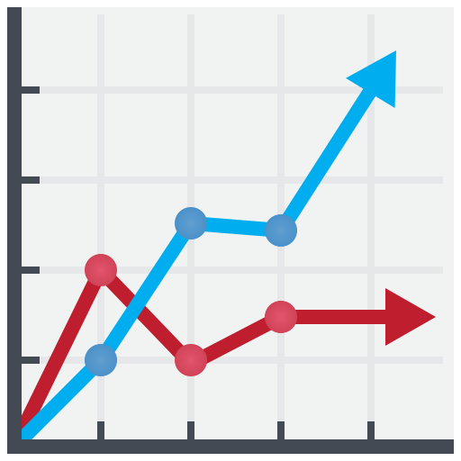

Project problem
Currently, the housing market (Real Estate) in Vietnam fluctuates constantly, so it is difficult for us to determine whether the value of the house we need to buy/sell is reasonable or not.
This project uses the house price dataset from https://www.kaggle.com/competitions/house-prices-advanced-regression-techniques/data
Thereby, it can be seen that there are many factors that affect the price of a house.

Slide 5
02. PROJECT SCOPE

Slide 6


The dataset in Iowa state, US, can apply the same to cities in Vietnam
Understand methods of processing tabular data
Choose the suitable model
Notes:
- Although the dataset for the project is in Boston US, through this project we can apply the same to cities in Vietnam if we have the data.
- Through this project, it is possible to understand some methods of processing tabular data
- How to choose the suitable model

Slide 7

Applying machine learning to save money and time.
This is regression problem
Inputs are information of the house, the output is the predicted price of the house.
Notes:
- Although the dataset for the project is in Boston US, through this project we can apply the same to cities in Vietnam if we have the data.
- Through this project, it is possible to understand some methods of processing tabular data
- How to choose the suitable model

Slide 8
03. DATASET

Slide 9
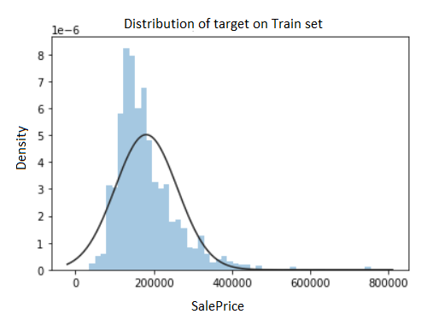
Dataset
Train set has 1460 records about 1460 houses in Iowa state, US
There are total 80 columns:
79 feature columns
1 target column (SalePrice)
Test set has 1459 records with total 79 columns:
79 feature columns
There is no target
(submit to Kaggle for scoring)

Slide 10
04. DATA PREPROCESSING

Slide 11
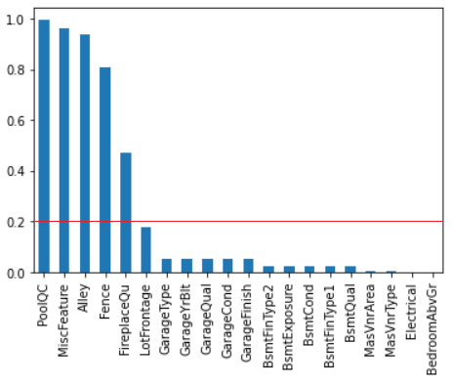
Missing data
Categorical encoding
Outlier
Rare labels
Feature creation
Feature scaling
Feature selection

Slide 12
Missing rate > 20%
- 5 features
- Remove MiscFeature
- Impute “NA” to the others, “NA” is a category (NA mean not exist)
Missing rate < 20%
- 14 features
- Impute “NA” to Basement and Garage features (NA mean not exist)
- KNN imputer for LotFrontage
- Mean, Mode for the others

Slide 13
There are 43 categorical features
Ordered encoding (Neighborhood, Exterior1st, Exterior2nd)
Missing data
Categorical encoding
Outlier
Rare labels
Mean encoding (for MSSubclass)
One-hot encoding (the others)
Feature creation
Feature scaling
Feature selection

Slide 14
Outliers
Missing data
Categorical encoding
Remove
Replace by its limit
Outlier
Rare labels
Normal distribution
low_limit = mean - 3*std
Up_litmit = mean + 3*std
Skew distribution
Low litmit = Quantile3 + 1.5*IQR
Up limit = Quantile1 – 1.5*IQR
Feature creation
Feature scaling
Feature selection

Slide 15
Rare labels
Appearance rate < 5%
Create a new category for rare labels
Missing data
Categorical encoding
Before grouping rare labels
After grouping rare labels
TA 0.897
NA 0.055
Fa 0.033
Gd 0.009
Ex 0.002
Po 0.002
TA 0.897
NA 0.055
RARE 0.046
Outlier
GarageQual
Rare labels
Feature creation
Feature scaling
Feature selection

Slide 16
Adding 5 new features
Missing data
YrBltAndRemod = YearBuilt + YearRemodAdd
TotalSF = TotalBsmtSF + 1stFlrSF + 2ndFlrSF
Total_sqr_footage = BsmtFinSF1 + BsmtFinSF2 + 1stFlrSF + 2ndFlrSF
Total_Bathrooms = FullBath + 0.5*HalfBath + BsmtFullBath + 0.5*BsmtHalfBath
Total_porch_sf = OpenPorchSF + 3SsnPorch + EnclosedPorch + ScreenPorch + WoodDeckSF
Categorical encoding
Outlier
Rare labels
Feature creation
Feature scaling
Feature selection

Slide 17
No scaling
Missing data
StandardScaler
Categorical encoding
Create 4 instances of scaling on numerical features
Outlier
MinMaxScaler
Rare labels
Feature creation
RobustScaler
Feature scaling
Feature selection

Slide 18


Missing data
01
02
03
Categorical encoding
Select features by using statistical methods.
Check Constant or Quasi-constant features
Check duplicated features
Check features with low correlation to label
Select features by using LASSO algorithrm.
GridSearchCV with Lasso
Only 2 features selected
125 features with coefficients shrank to 0
Select features by using Recursive Feature Elimination.
Estimator: Gradient Boosting Regressor
125 features selected in total 127 features
Outlier
Rare labels
Feature creation
Feature scaling
Feature selection

Slide 19
05. MODELING

Slide 20
Model selection
Algorithms | Model with sklearn
Ridge | Ridge(alpha = 1e+2, tol = 0.0001, random_state=10)
Decision Tree | DecisionTreeRegressor(random_state=10)
Elastic Net | ElasticNet(alpha = 1e+1, l1_ratio = 0.01, tol = 0.001, random_state=10)
Gradient Boosting | GradientBoostingRegressor(n_estimators=1000, max_depth=6, random_state=10)
XGB | XGBRegressor(objective ='reg:squarederror', n_estimators = 1000, seed = 10)

Slide 21
Model selection
 | No scaler | Standard Scaler | MinMax Scaler | RobustScaler
Ridge Regression | 0.1305 | 0.1298 | 0.1552 | 0.1316
Decision Tree Regressor | 0.2022 | 0.2018 | 0.2002 | 0.2016
Elastic Net | 0.1593 | 0.2514 | 0.2727 | 0.2510
Gradient Boosting Regressor | 0.1298 | 0.1293 | 0.1288 | 0.1296
XGB Regressor | 0.1317 | 0.1318 | 0.1322 | 0.1317
Pick 3 best models

Slide 22
Hyperparameter tuning
Choose 3 best models for tuning hyperparameters
Ridge regression
RMSE: 0.1298
Gradient Boosting Regressor
RMSE: 0.1293
XGBRegressor
RMSE: 0.1318

Slide 23
Hyperparameter tuning
Score Models | RMSE | Grid search hyperparams | Best hyperparams
Ridge Regression | 0.1289 (CV=5) | parameters = { 'alpha': np.logspace(-3, 3, 10), 'tol': [1e-2, 1e-3, 1e-4] } | { 'alpha': 46.4158883, 'tol': 0.01 }
Gradient Boosting Regressor | 0.1184 (CV=5) | parameters = { 'learning_rate': np.logspace(-3, -1, 10), 'subsample' : [0.9, 0.7, 0.5], 'n_estimators' : [1000, 1500, 2000], 'max_depth' : [4,6,8] } | { 'learning_rate': 0.00774, 'max_depth': 4, 'n_estimators': 1500, 'subsample': 0.5 }
XGB Regressor | 0.1218 (CV=5) | Parameters = { "learning_rate": np.logspace(-3, -1, 10), "max_depth": [4, 5], "n_estimators": [1000, 1500, 2000] } | { 'learning_rate': 0.035938, 'max_depth': 4, 'n_estimators': 1000 }
Pick the best model for traing

Slide 24
Training model
Gradient Boosting Regressor is having the best performance, we use it for training.
#Training GradientBoostingRegressor with best hyperparams and standard scaler
gbr_model = GradientBoostingRegressor(
learning_rate=0.00774,
max_depth=4,
n_estimators=1500,
random_state=42,
subsample=0.5)
The CV score = 0.1182 (CV=10)
The test score (on Kaggle) = 0.13703
The model is overfitting

Slide 25
06. EVALUATING & IMPROVING MODEL

Slide 26
Scoring
Root mean square error of log of label (RMSE of log(label))
- Smaller is better
R2 score (for tuning hyperparameters along with RMSE)
- Higher is better

Slide 27
Evaluating & Improving model
The model is overfitting, we try reducing number of features by using statiscal methods.
Remove columns: ignored_cols =['MiscFeature', 'MiscVal', 'PoolArea', '3SsnPorch', 'GarageCars', 'Utilities']
Then the result is
Before dropping ignored_cols
The CV score = 0.1182
The test score (on Kaggle) = 0.13703
After dropping ignored_cols
The CV score = 0.1192
The test score (on Kaggle) = 0.12459

Slide 28
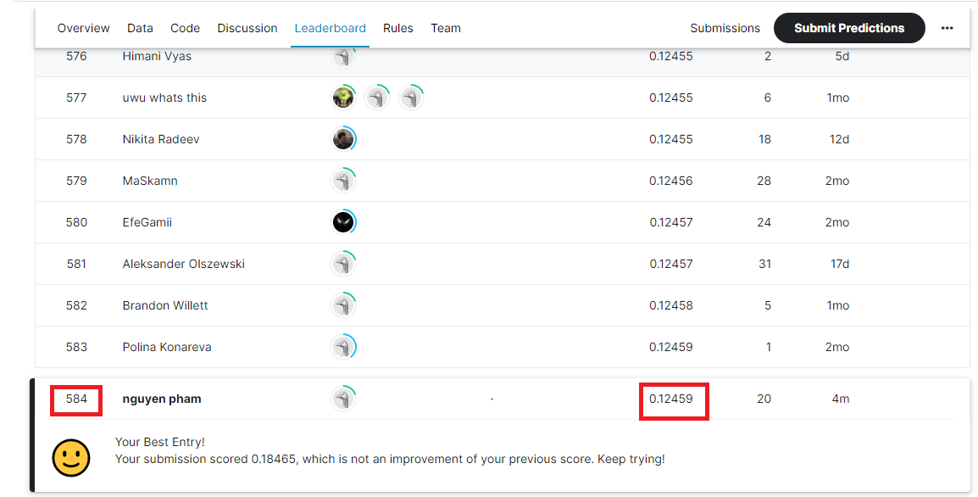
Submit to Kaggle
October 10, 2022

Slide 29
THANK
YOU!

